Slide 1
The Modern Age
Floritto Francesco
5^ B
(1890-1930)

Slide 2
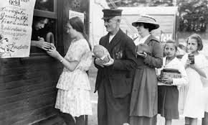
End of Victorian Idea of progress
Conflicts between modernized nations began for international competition for raw material markets and control of trade routes
1914 : First Word War: many people, shocked by it, lose their faith in liberal democracy, capitalism and Victorian idea of progress
Science and industry had finally just brutalized men and made their powers of destruction greater
After 1920 U.S.A. and Russia replaced France and Britain as the two great powers and U.S.A. capital became the dominant force in many developing countries

Slide 3
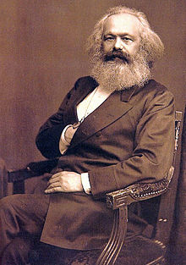
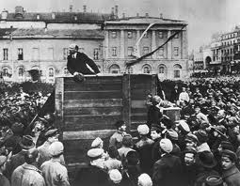
Lost of Victorian values – Rise of Marxism
Economic depression in 1870’s and 1880’s had shown that ‘laissez-fair’ would not serve the public good or produce benefits for everyone.
The foundations of the modern Welfare State were laid as answer to the pressure made by the working class to this situation.
Marx in The Communist Manifesto (1848) had suggested to establish a fully socialist society taking power away from middle class.
In 1917 Lenin and Bolshevik party took control of Russian state in the name of Russian working class. Marxism shown an optimistic secure view of the future.
The Victorians most profound fear was however religious; They were afraid to live a life without meaning and God: they had no point of reference so they could believe only to himself and decide what was right and what wrong.
C.Marx
V. Lenin

Slide 4
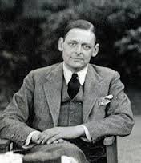
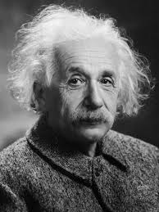
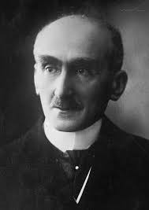
Doubt, insecurity, sense of isolation
Also writers had no values, surely valid for everyone, to confidently refer. So they left characters speak for themselves, to present their own version of reality without offer an alternative point of view to the reader
Novelists disappeared from his own work
In the Physics A. Einstein in 1906 said in his General Theory of Relativity that time changed according to the point of view of the observer
In the Philosophy William James (USA) and Henri Bergson (France) rejected the conventional idea of time as an independent medium which contains events. Past and future exist together with present in people’s mind and this fusion is described by Bergson like a ‘stream of consciousness’; this stream determines the person’s thinking.
T.S. Eliot
A. Einstein
H. Bergson

Slide 5

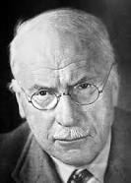
Psychology
Sigmund Freud in his ‘The Interpretation of Dreams (1900) argued that the people’s behaviour depends on the unconscious part of their minds ( motivated by instincts and controlled by their social conditioning - Superego)
Freud work made difficult to see man as a responsible creature free to take decisions for himself ( after 1910)
Jung in ‘Psychology of the Unconscious developed the concept of racial memory that is the primitive memory preserved by each individual of the experience of his race during his evolution.
Jung underlines that people responded to certain figures and object without realizing it;
French Symbolist poets understood the importance of this symbolic meanings and starts writing using a language which spoke to the irrational rather than the rational in the reader. (Mallarme)
S. Freud
C. Yung

Slide 6
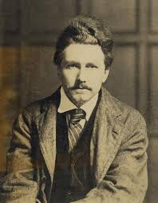
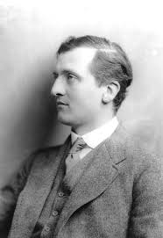
T.S. Eliot and Ezra Pound
Symbolists poets influenced the writers of the Aesthetic Movement and also Ezra Pound and T.S.Eliot; these two poets who came from America to England produced poetry which broke completely with Victorian tradition.
Hulme condemned the Romantic idea that art was only a matter of self expression on the part of the artist. He wanted writers to return to Neo-Classicism idea of man, recognizing man’s limitations and not exaggerate his importance. Hulme influenced a whole generation of poets and in particular T.S.Eliot.
Another movement that influenced Pound and Eliot was the Imagist Movement; they tried to produce poetry which reflected the cold, mechanical reality of the modern world in contrast with the soft, pastoral nature of Georgian verse.
Eliot and Pound wrote deliberately difficult and obscure, filling their works of literary references beyond the education of most readers
Ezra Pound
T.E.Hulme

Slide 7
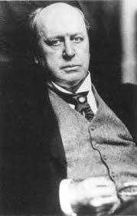
New Dramatic Novel
The narrator is always there but is invisible such as in drama
Characters tell and represents the story
The story is self –told
The author is hidden or doesn’t appear.
The analysis is transferred from novel to the reader
The absence of comments , judgments and interferences by the author, permeate the novel of ambiguity and uncertainty.
Aesthetic values have take the place of moral values in modern novelists
H. James turns inside people’s conscience to explore the flux of his mental experience ( stream of consciousness); the reader must discover his identity and not only reconstruct the characters; the main characteristics of modern prose is evident by now.
H. James

Slide 8
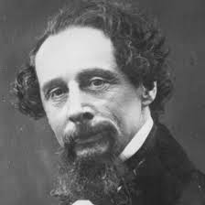
Old Novel
Old Novel is mostly a narrative structure ; New novel is essentially a dramatic structure
The narrator is omniscient, always present and visible both in 3rd person and in 1st person narrations and often the protagonist speaks with the same voice of the author
If we compare the narrative structure with the word of cinema the analogy is as follows:
summary is a panoramic vision
description is a close up
scene is sonorous
C. Dickens

Slide 9
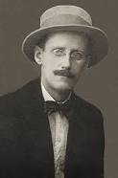
Eliot mythical method
Eliot use the anthropological material ( myth and ritual) as a way to ordering and transforming into significance contemporary experience.
Eliot after the‘ The Waste Land’ is explicit about the technical function of the myth and ritual; In his review of the Joyce’s Ulysses he explains how the myth of Ulysses and Odyssey parallel were used as a structural device to give ‘a shape and significance to the immense panorama of futility and anarchy which is contemporary history’
The ‘immense panorama’ is presented by Eliot in different way of Joyce; he condenses it by compression and allusions where Joyce expands the moment almost to infinite
J. Joyce

Slide 10
Eliot’s objective correlative
Eliot used the tem ‘objective correlative’ in an essay ‘On Hamlet’ to explain that the only way of expressing emotions is using a set of objects, a situation a chain of events which shall be the formula of that particular emotion ;
Eliot suggest that in Lady Macbeth’s sleep walking speech and in the speech that Macbeth makes when he hears of his wife death , the words are completely adequate to the state of mind as for Hamlet .
A good balance between form and matter could produce a successful artistic creation; The form were the words and the matter were thought, feeling, action ; if the right balance would be not reached we have not found the ‘formula’ and the result would be poor.

Slide 11
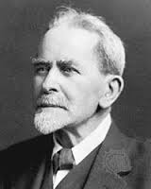
Anthropology
In 1890 appeared the first edition of The Golden Bough by J. Frazer
New interest for mythology and pre-history out of the Symbolist Movement and from the Darwin’s theories.
The sources of art lay in the unconscious ( both collective and personnel one)
In writing or painting we follow a set patterns of behaviour and use ancient symbols but we are not awareof this consciously.
Fraser discussed the myth of the Grail , primeval customs, fertility rites etc..
He was above all interested in the man beneath the surface of so called ‘civilization’ writing that he wished to investigate the ‘solid layer of savagery beneath the crust of society’
J. Frazer

Slide 12
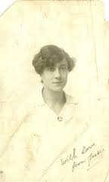
Jessie L. Weston’s From Ritual to Romance
She performs a complex synthesis (historical and geographical) behind the 12th century medieval Grail legends.
She asserted that in the Grail King we can find a romantic literary version of the strange mysterious figure whose presence we can hear in the history of our Aryan races;
This mysterious figure of a ‘divine or semi-divine ruler at one Good and King, upon whose life, and unimpaired vitality, the existence of his lord an people directly depend’.
J.Weston

